Slide 1
Hands On Machine Learning
Chapter 03. Classification
Sin-sa
sinsa240903@inha.edu
2024.09.12

Slide 2
INDEX
3.1 MNIST
3.2 Binary Classifier
3.3 Performance measurement
3.4 Multi-classification
3.5 Error Analysis
3.6 Multi-label Classification
3.7 Multi-output Classification

Slide 3
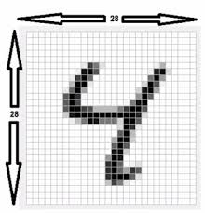
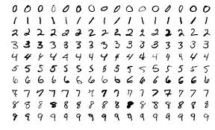
3.1 MNIST

Slide 4
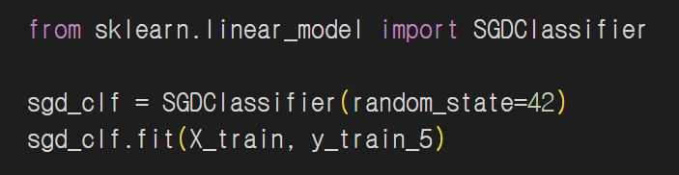
3.2 Binary Classifier
A machine learning model that classifies input data into one of two mutually exclusive classes. It is used to predict one of two outcomes.
Ex) True/False, Spam/Not Spam, Positive/Negative.
Stochastic Gradient Descent (SGD): One of the optimization algorithms used to minimize the loss function.

Slide 5
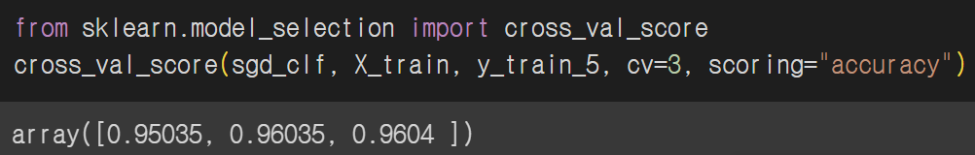
3.3 Performance measurement
1) accuracy with cross-validation
K-fold cross-validation: The data is divided into k folds to perform k repetitive learnig and verification (1 verification data, k-1 learnig data)
Benefits: Overfitting prevention, better generalization performance assessment, all data utilzation

Slide 6
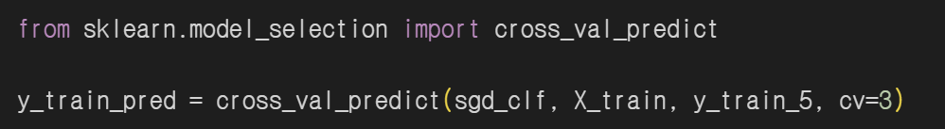
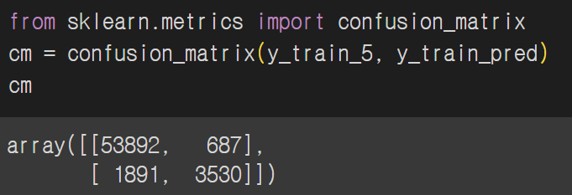
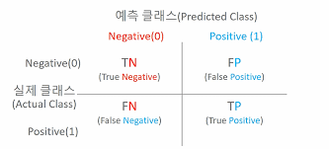
3.3 Performance measurement
2) Confusion Matrix

Slide 7
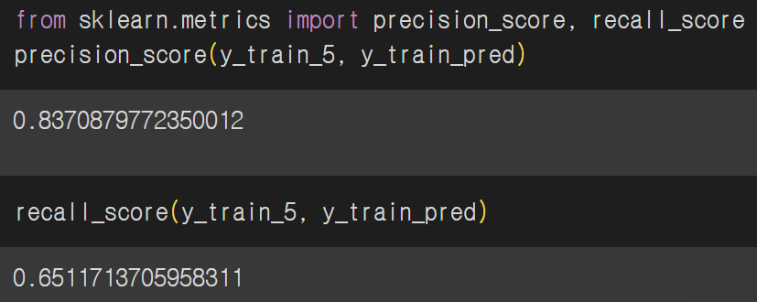
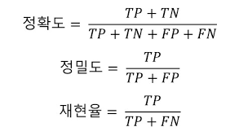
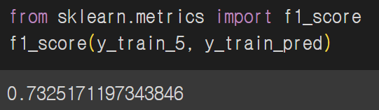
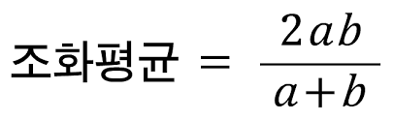
3.3 Performance measurement

Slide 8
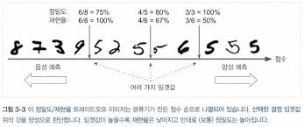
3.3 Performance measurement
4) Precision/Recall Trade-off

Slide 9
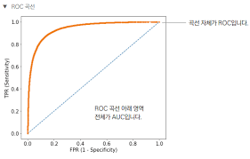
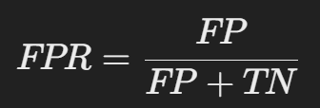
3.3 Performance measurement
5) ROC curve : The curve of the true positive rate(TPR) for the false positive rate(FPR)

Slide 10
3.4 Multi-classification
Binary class vs Multi class
{Logisitic, SVM} vs {SGD, Random Forest, Naïve Bayes}
Multi-classifier
OvR vs OvO
OvR: 0 or rest, 1 or rest, … in n classifiers
OvO: 0 or 1, 0 or 2, … in nC2 classifiers

Slide 11
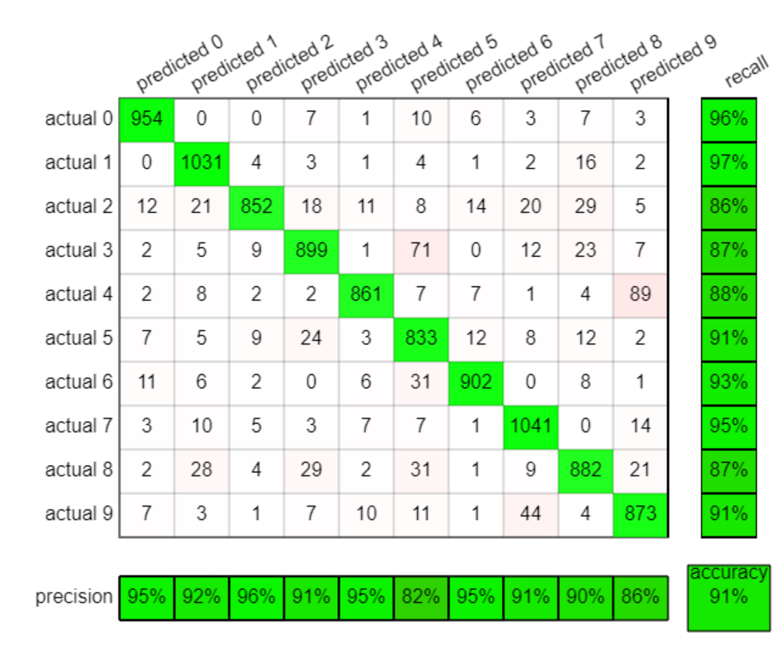
3.5 Error Analysis
Confusion matrix
At the precision, we can see that the model has the lowest precision in predicting the number 5, and in this case, the model most frequently misclassified 3 as 5.
Among all the precisions, the model most frequently misclassified 4 as 9
https://ml4a.github.io/demos/confusion_mnist

Slide 12
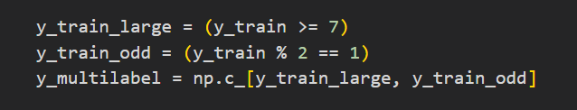
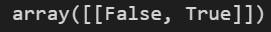
3.6 Multi-label Classification
Multi-label classification involves cases where a single sample can belong to multiple classes
If you want to classify whether a number is greater than 7 and whether it is odd, the output will be represented as an array for these two labels.

Slide 13

3.7 Multi-output Classification
Multi-output classification refers to a type of multi-label classification where each label can have multiple classes.
Classifying each pixel of an MNIST image as a label and its value as a class is an example of Multi-output Classification.

Slide 14
Thank You For Listening

